Slide 1
Casy study: Leaf area index of green facades
5-Digital Image Processing
Anouk De Bock

Slide 2
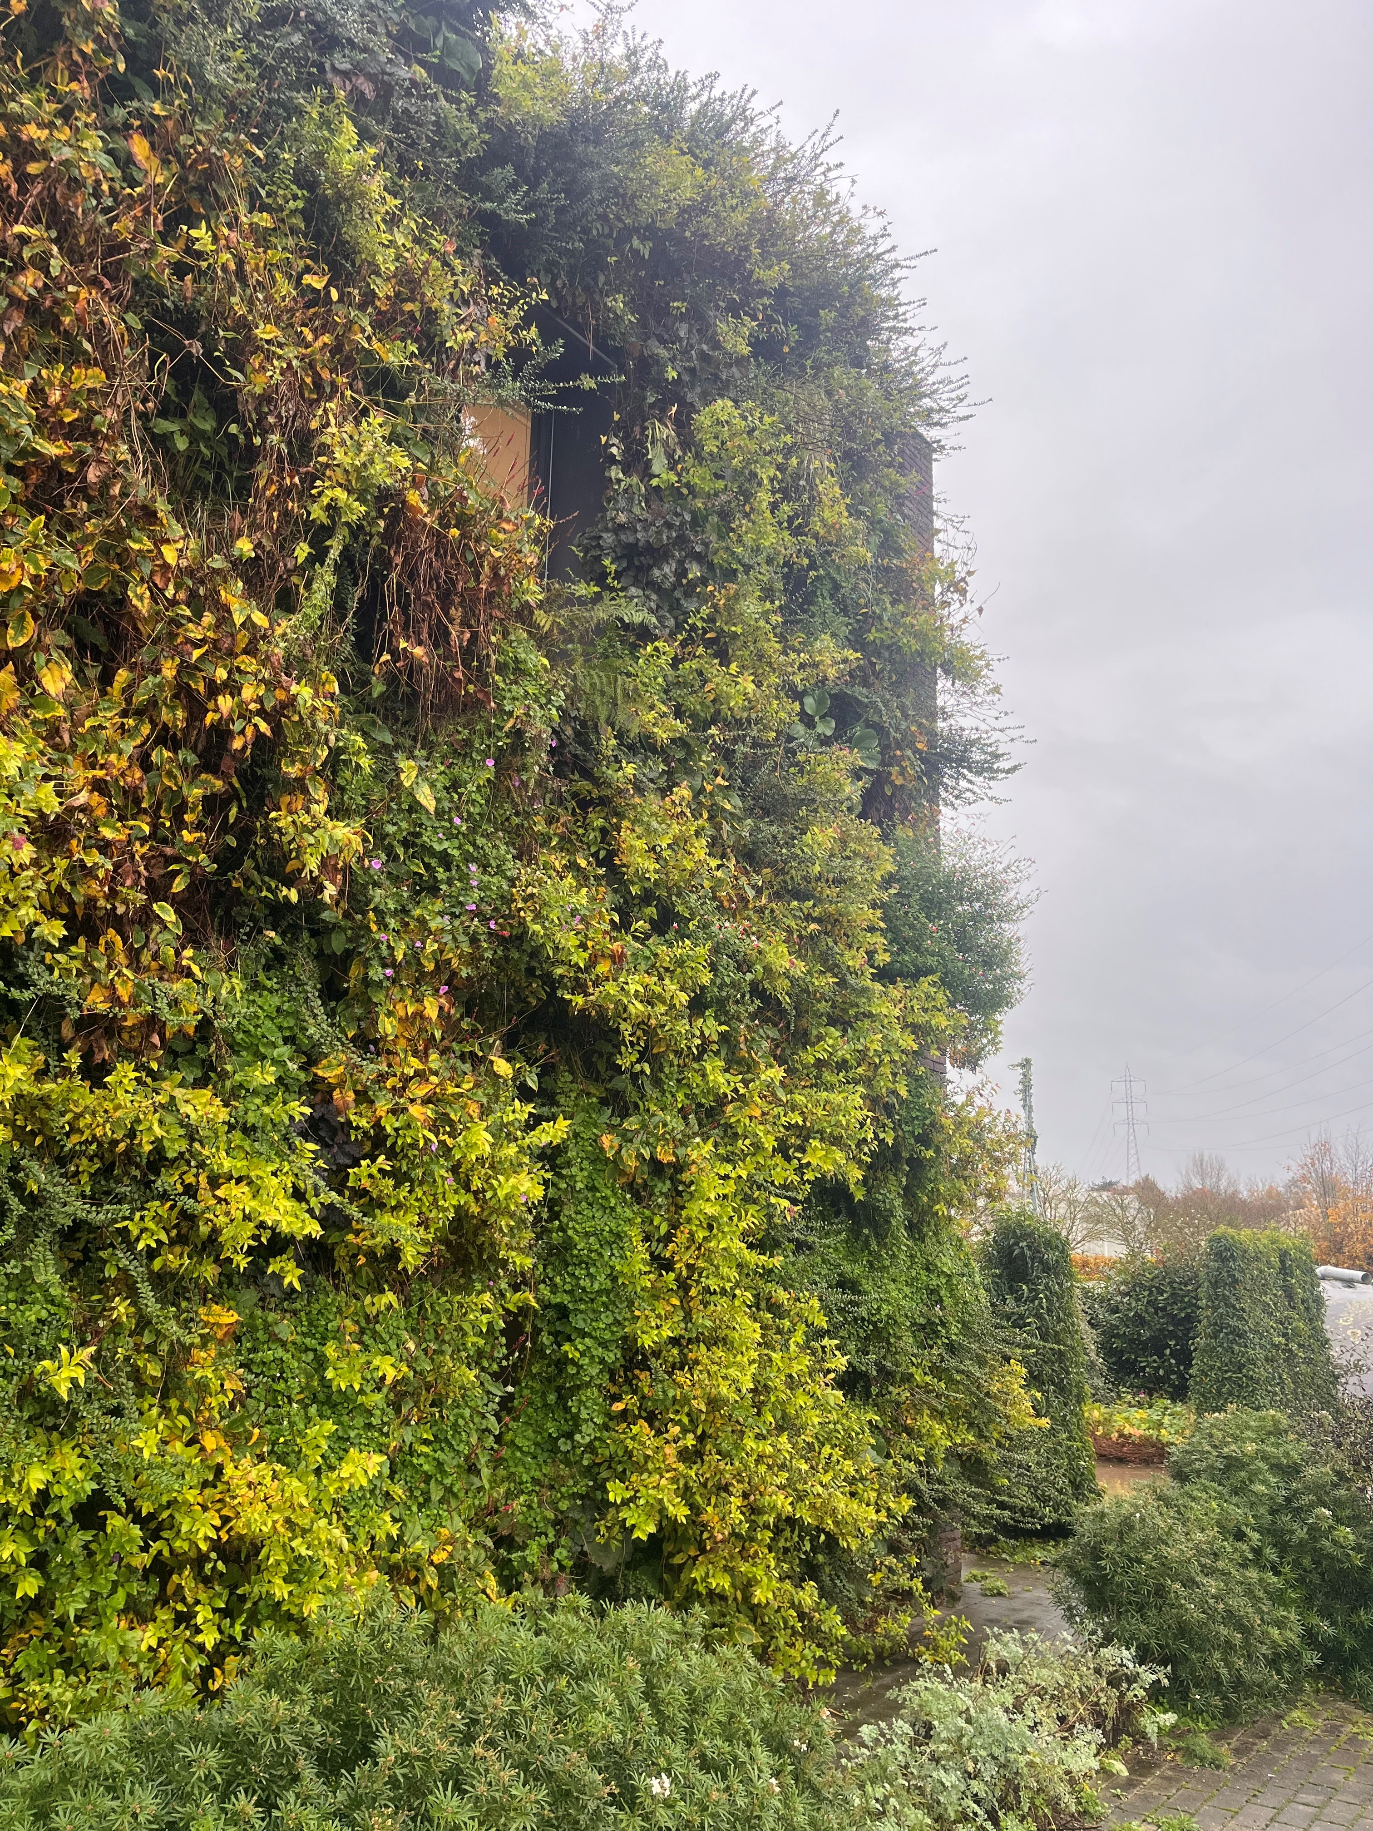




Green facades
Innovative way to introduce more green in cities
Benefits
Thermal cooling
Capturing fine dust
Noise reduction
Biodiversity
Benefits related to the total amount of leaf area in the canopy
→ Leaf area index
→ Important parameter to measure!
Notes:
These benefits depend mainly on the amount of leaves in the canopy, where the higher the amount of leaves, the higher the benefits. The total leaf area is expressed in a vegetation index, namely the leaf area index, and this is an important parameter to measure in green facades since we want to be able to quantify these benefits.

Slide 3
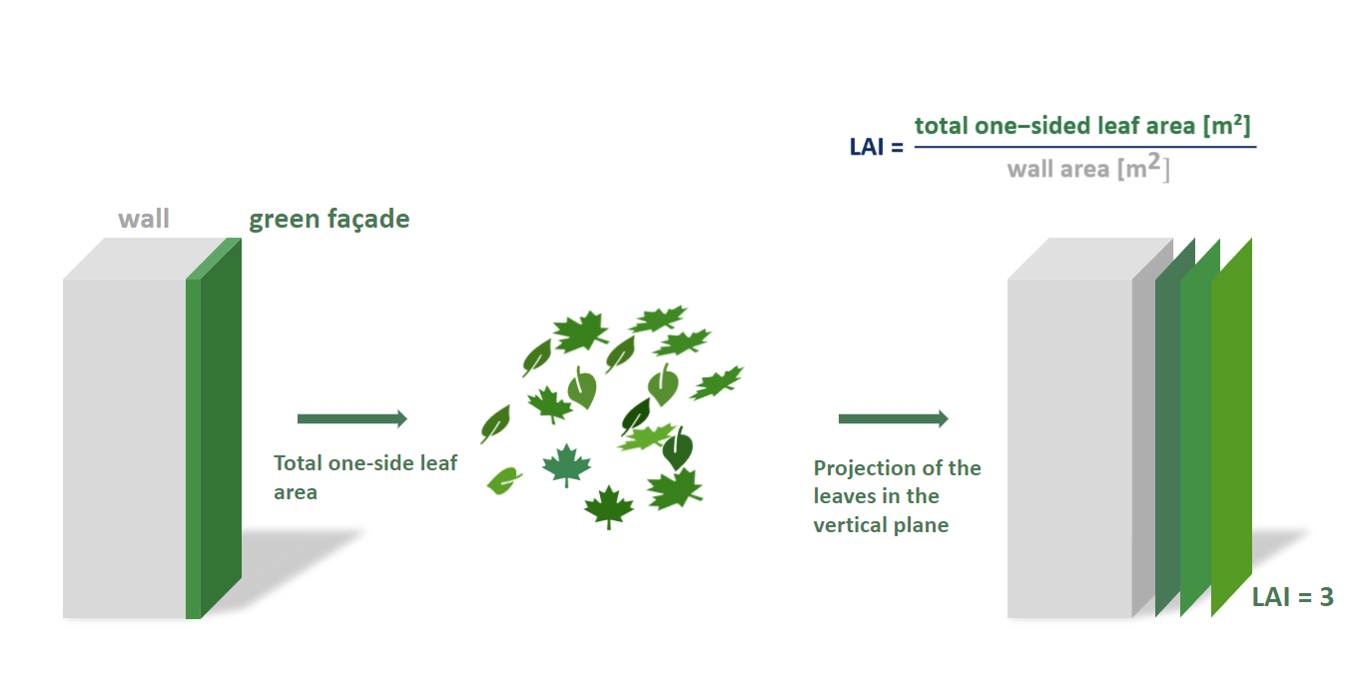
Leaf area index
Notes:
The LAI is dynamic parameter and subject to change due to variations in internal and external factors such as plant species type, seasonality, orientation, nutrient availability, diseases, etc.
Therefore it is important to monitor this parameter in time.

Slide 4
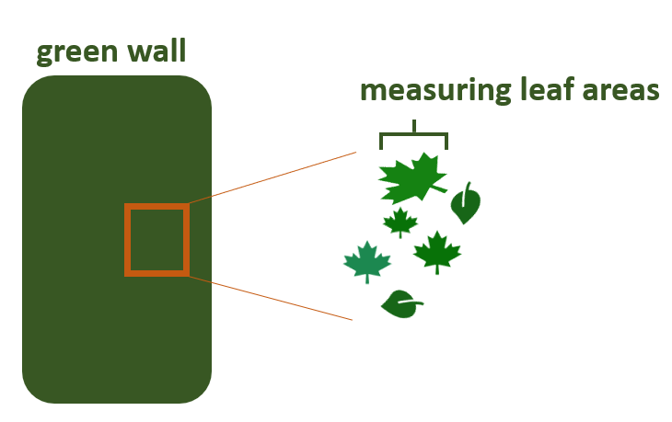
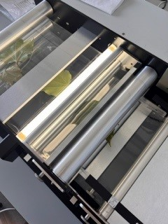
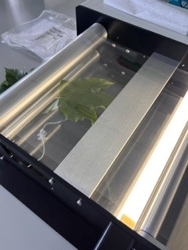
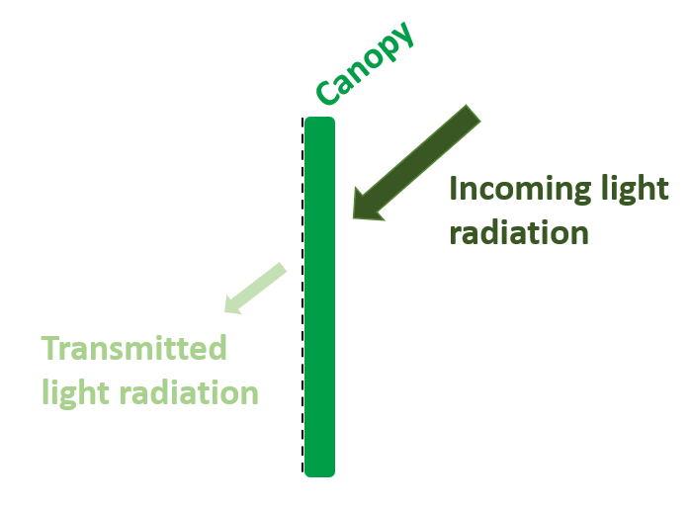
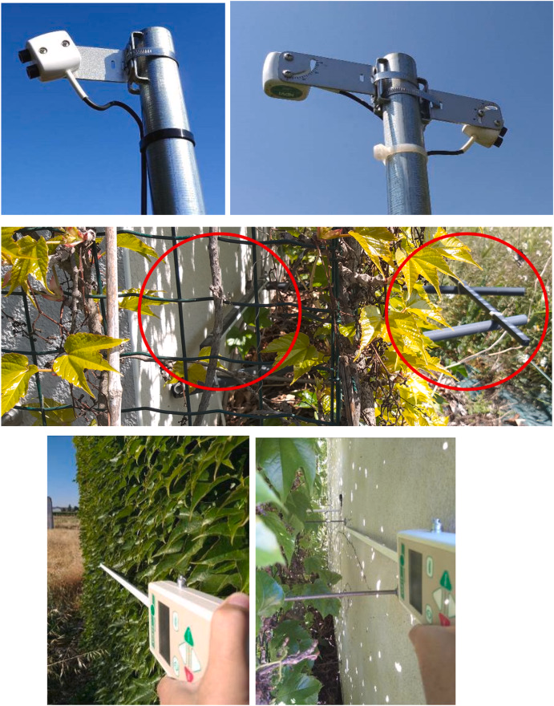
Leaf area index – measuring techniques
Destructive leaf harvesting (LI-3100C leaf area meter)
Radiative transfer theory (LAI-2200C meter)
Time-consuming
Destructive measurements
Isolated LAI values
Continuous monitoring is not feasible
Spatial variability overlooked
Not sensitive to high LAI
Image-based LAI monitoring?
Source: Pérez et al. 2022

Slide 5
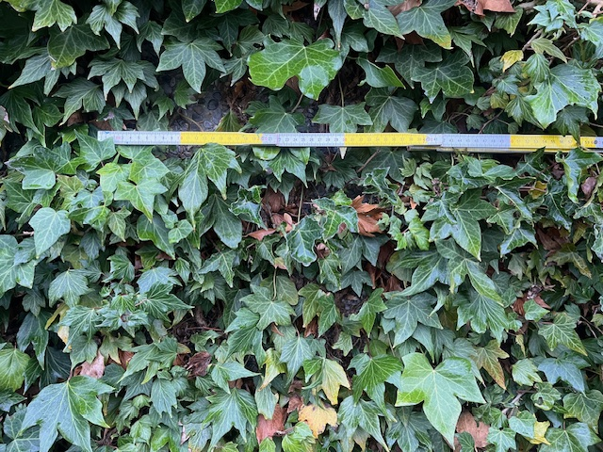
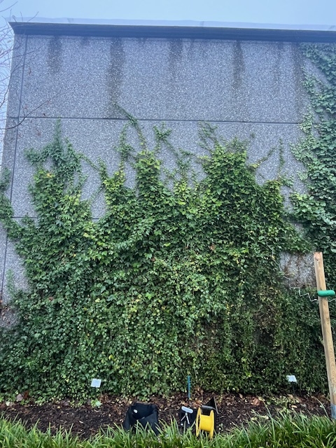
Casy study – PCS sierteelt (Gent)
Demo wall with different Hedera helix species
3 different levels of vegetation coverage (low, medium, high)
20 cm
20 cm

Slide 6
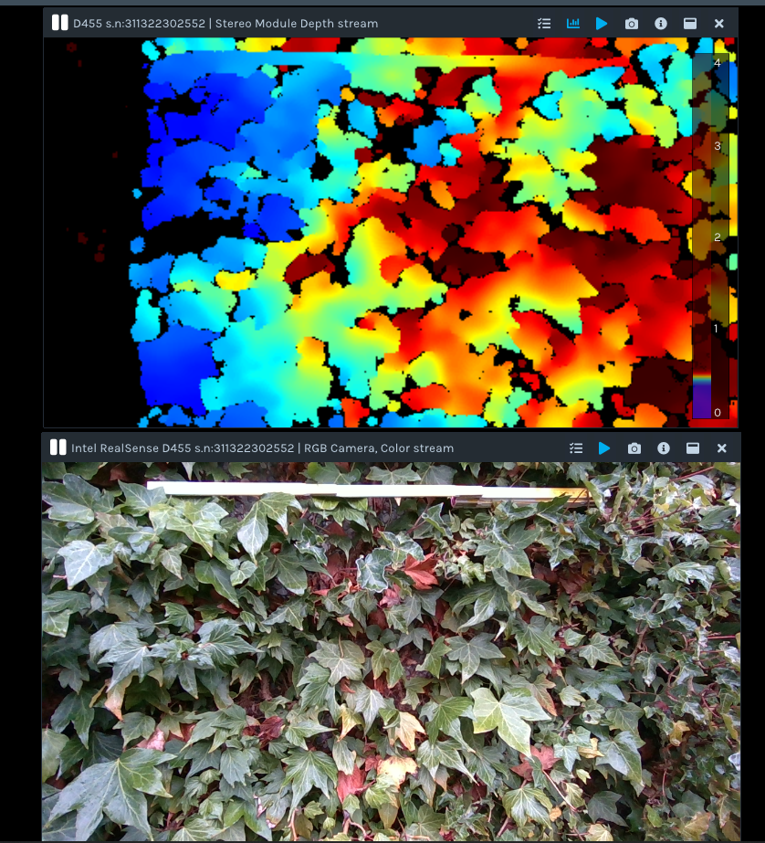
Leaf area index
RealSense D455 camera
RGB and depth image
Goal:
Find an approximation for the LAI
Validation with destructive measurements
Points to consider
Overlapping leaves
Different light intensities
Brown leaves
Sensitivity at high LAI (LAI>3)?

Slide 7
Contact info
Questions?
E-mail: anouk.debock@uantwerpen.be
Office: Campus Groenenborger - G.Z.342
References:
A. De Bock, B. Belmans, S. Vanlanduit, J. Blom, A.A. Alvarado-Alvarado, A. Audenaert. A review on the leaf area index (LAI) in vertical greening systems. Building and Environment, 229 (2023), 10.1016/j.buildenv.2022.109926.
G. Pérez, J. Coma, M. Chàfer, L.F. Cabeza. Seasonal influence of leaf area index (LAI) on the energy performance of a green façade. Build. Environ., 207 (2022), 10.1016/j.buildenv.2021.108497.

